Slide 1
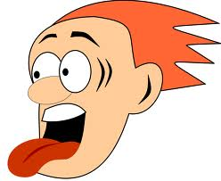
James 3:1-10 The Tangle of the Tongue

Slide 2
The Tongue is Disruptive!
Not many of you should become teachers, my fellow believers; because you know that we who teach will be judged more strictly.
Matthew 12:36-37 - I tell you, on the day of judgment people will give account for every careless word they speak, for by your words you will be justified, and by your words you will be condemned.”

Slide 3
The Tongue is Destructive!
Likewise, the tongue is a small part of the body, but it makes great boasts. Consider what a great forest is set on fire by a small spark.
Proverbs 15:4 - Kind words are good medicine, but deceitful words can really hurt.

Slide 4
The Tongue is Deadly!
It is a restless evil, full of deadly poison
Proverbs 12:18 - There is one whose rash words are like sword thrusts,

Slide 5
The Tongue is Depressing!
With the tongue we praise our Lord and Father, and with it we curse human beings, who have been made in God’s likeness. Out of the same mouth come praise and cursing. My brothers and sisters, this should not be.
Proverbs 18:21 - Death and life are in the power of the tongue,

Slide 6
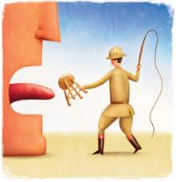
Psalm 73:26
My flesh and my heart may fail, but God is the strength of my heart and my portion forever.

