Slide 1
The Suffering Question Suffering Defined

Slide 2
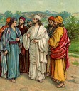
Infirmities
Weaknesses
Sickness

Slide 3
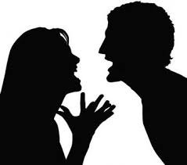
Reproaches
Insults
Mental Hurt

Slide 4
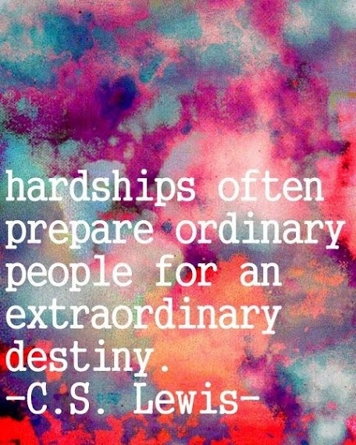
Needs
Hardships
Regard to one’s Advantage

Slide 5
Persecutions
Oppositions
Deogmo’s (Greek)

Slide 6
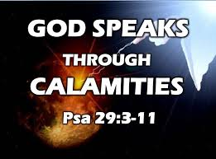
Distress
Troubles (Extreme Afflictions)
Calamities

Slide 7
Psalm 119:71
My suffering was good for me, for it taught me to pay attention to your decrees.

