Slide 1
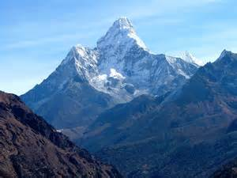
Jesus Mover of Mountains
Matthew 17:19-21
Then the disciples came to Jesus privately and said, “Why could we not cast it out?” So Jesus said to them, “Because of your unbelief(little faith) for assuredly, I say to you, if you have faith as a mustard seed, you will say to this mountain, ‘Move from here to there,’ and it will move; and nothing will be impossible for you. However, this kind does not go out except by prayer and fasting.

Slide 2
Jesus Mover of Mountains
Faith may not change the outer but it will always strengthen the inner.
Deeper
It’s not the smallness of the seed it what deep in us.

Slide 3
Jesus Mover of Mountains
Faith in God always enlarges our option.
Maybe God moves us instead of the mountain.
Jesus died on the cross, God option was to raise Him form the dead.

Slide 4
Jesus Mover of Mountains
Faith that moves mountains requires that we connect.
Prayer
Fasting
Word

Slide 5
What Mountain needs to be moved today?

Slide 6
646-832-4848
wood

