Slide 1
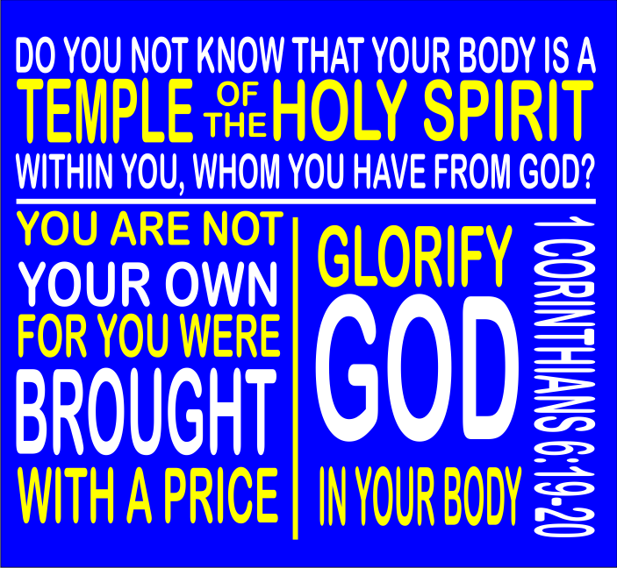

Slide 2
BODY BY GOD
I Corinthians 6:19-20
Don’t you realize that your body is the temple of the Holy Spirit, who lives in you and was given to you by God? You do not belong to yourself, for God bought you with a high price. So you must honor God with your body.

Slide 3
Why Honor?
• The Beginning
  o Genesis 2:7
  o Psalm 139:13-14- For you formed my inward parts; you knitted me together in my mother's womb. I praise you, for I am fearfully and wonderfully made.

Slide 4
Why Honor?
• The Building
  o I Corinthians 6:19-20
  o 1 Corinthians 3:16-
  Do you not know that you are God's temple and that God's Spirit dwells in you?

Slide 5
Why Honor?
• The Baby
o John 1:14 – The Word began Flesh….
  o Luke 2:12 - Find a child wrapped in cloths…….

Slide 6
Why Honor?
• The Beauty
  o I Corinthians 15:40-There are also bodies in the heavens and bodies on the earth. The glory of the heavenly bodies is different from the glory of the earthly bodies.
  o 1 Thessalonians 4:14 – He will return and the dead…

Slide 7
Why Honor?
• The Behavior
  o Romans 12:1-I appeal to you therefore, brothers, by the mercies of God, to present your bodies as a living sacrifice, holy and acceptable to God, which is your spiritual worship.
    o Philippians 1:20-

Slide 8
Why Honor?
Are you Honoring?

