Slide 1
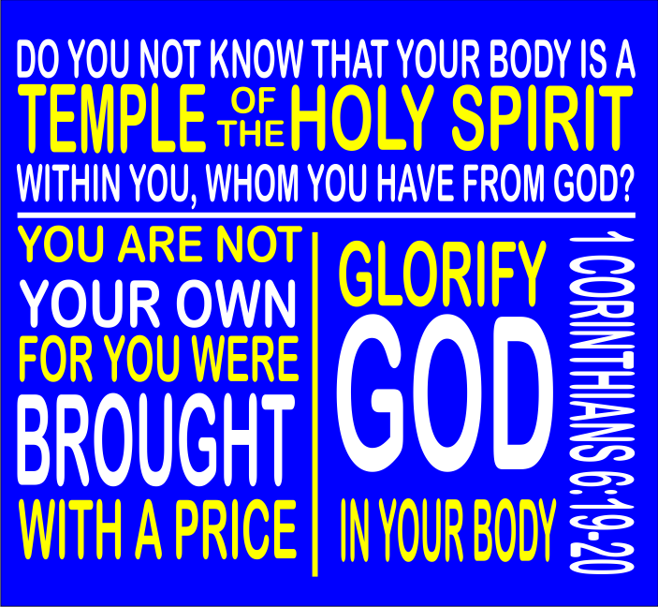

Slide 2
BODY BY GOD
I Corinthians 6:19-20
Don’t you realize that your body is the temple of the Holy Spirit, who lives in you and was given to you by God? You do not belong to yourself, for God bought you with a high price. So you must honor God with your body.

Slide 3
HEALTHY EATING HABITS
6 Realizations to have a body by God
  Food does not bring us near to God
    1 Corinthians 8:8a It’s true that we can’t win God’s approval by what we eat.

Slide 4
HEALTHY EATING HABITS
6 Realizations to have a body by God
  Before food think: What am I feeling? How much do I really need ?
  Proverbs 23:1-3, MSG When you go out to dinner with an influential person, mind your manners: Don’t gobble your food, don’t talk with your mouth full. And don’t stuff yourself; bridle your appetite
  Proverbs 23:20-21, MSG Don’t drink too much wine and get drunk; don’t eat too much food and get fat. Drunks and gluttons will end up on skid row, in a stupor and dressed in rags.

Slide 5
HEALTHY EATING HABITS
6 Realizations to have a body by God
  Food worries wastes time.
    Matthew 6:25-27 Do not worry about your life, what you will eat or drink; or about your body, what you will wear. Is not life more important than food, and the body more important than clothes? Look at the birds of the air; they do not sow or reap or store away in barns, and yet your heavenly Father feeds them. Are you not much more valuable than they? Who of you by worrying can add a single hour to his life.

Slide 6
HEALTHY EATING HABITS
6 Realizations to have a body by God
  Foods from the earth are healthiest
    Psalm 24:1 The earth is the LORD’s, and all its fullness.
    Daniel 1:8, 12,13,15 But Daniel resolved not to defile himself with the royal food and wine, and he asked the chief official for permission not to defile himself this way… ‘Please test your servants for ten days: Give us nothing but vegetables to eat and water to drink. Then compare our appearance with that of the young men who eat the royal food, and treat your servants in accordance with what you see.’ At the end of the ten days they looked healthier and better nourished than any of the young men who ate the royal food.

Slide 7
HEALTHY EATING HABITS
6 Realizations to have a body by God
  Food compulsions are not healthy.
    1 Corinthians 6:12, 20b Everything is permissible for me’ – but not everything is beneficial. ‘Everything is permissible for me’ – but I will not be mastered by anything… Therefore, Honor God with your body.
    Proverbs 10:17, MSG The road to life is a disciplined life; ignore correction and you’re lost for good.

Slide 8
HEALTHY EATING HABITS
6 Realizations to have a body by God
  Food friend accountability!
    “Though one may be overpowered, two can defend themselves. A cord of three strands is not quickly broken” (Ecclesiastes 4:12).

