Slide 1
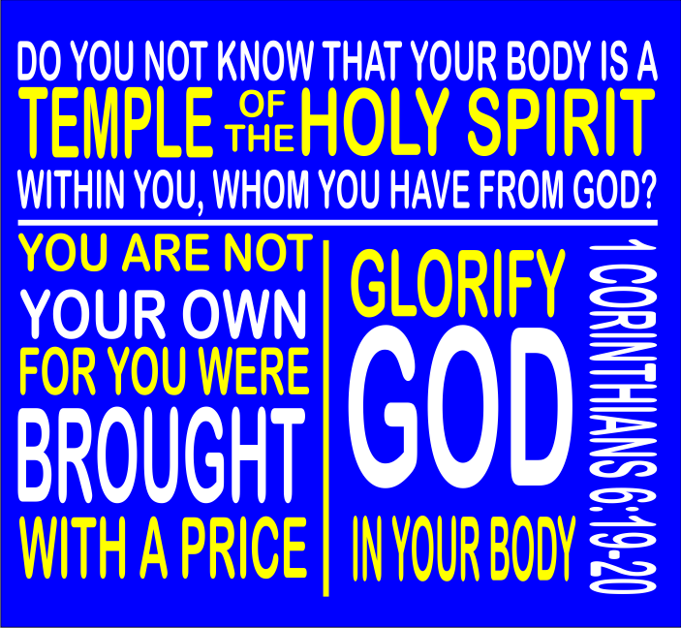

Slide 2
BODY BY GOD
I Corinthians 6:19-20
Don’t you realize that your body is the temple of the Holy Spirit, who lives in you and was given to you by God? You do not belong to yourself, for God bought you with a high price. So you must honor God with your body.

Slide 3
Mental Side
• ALLEGIANCE
I TIMOTHY 1:5 I am reminded of your sincere faith, a faith that dwelt first in your grandmother Lois and your mother Eunice and now, I am sure, dwells in you as well.

Slide 4
Mental Side
• CALL
I Samuel 1:10-11 Hannah was in deep anguish, crying bitterly as she prayed to the LORD. And she made this vow: “O LORD of Heaven’s Armies, if you will look upon my sorrow and answer my prayer and give me a son, then I will give him back to you. He will be yours for his entire lifetime, and as a sign that he has been dedicated to the LORD, his hair will never be cut.

Slide 5
Mental Side
• TRANSFORMATION
Romans 12:2 Do not be conformed to this world, but be transformed by the renewal of your mind, that by testing you may discern what is the will of God, what is good and acceptable and perfect.

Slide 6
Mental Side
• INTENT
Exodus 2: 3 But when she could no longer hide him, she got a basket made of papyrus reeds and waterproofed it with tar and pitch. She put the baby in the basket and laid it among the reeds along the bank of the Nile River.

Slide 7
Mental Side
• OFFER
Romans 12:1 I appeal to you therefore, brothers, by the mercies of God, to present your bodies as a living sacrifice, holy and acceptable to God, which is your spiritual worship.

Slide 8
Mental Side
• NEVER LOSS SIGHT
Psalm 100:3 Know that the Lord, he is God! It is He who made us, and we are his; we are his people, and the sheep of his pasture.

Slide 9
Mental Side
What is your
ACTION plan?

