Slide 1
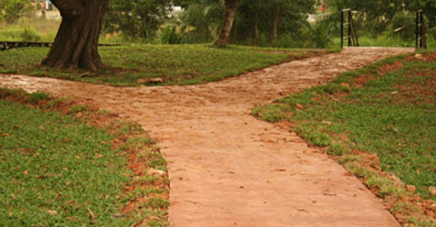
Genesis 12:1 The Lord had said to Abram, “Leave your native country, your relatives, and your father’s family, and go to the land that I will show you.

Slide 2
will require:
Life of Faith: Hebrews 11:1
Faith is the confidence that what we hope for will actually happen; it gives us assurance about things we cannot see.

Slide 3
will require:
Leaving the Comfortable:
Luke 5:10-11 Then Jesus said to Simon, “Don’t be afraid; from now on you will fish for people.” So they pulled their boats up on shore, left everything and followed him.

Slide 4
will require:
Looking for His Direction:
Proverbs 3:5-6 Trust in the Lord with all your heart, and do not lean on your own understanding. In all your ways acknowledge him, and he will make straight your paths.

Slide 5
will require:
Looking for His Direction:
Proverbs 3:5-6 Trust in the Lord with all your heart, and do not lean on your own understanding. In all your ways acknowledge him, and he will make straight your paths.

Slide 6
Isaiah 55:8-9
For my thoughts are not your thoughts, neither are your ways my ways, declares the Lord. For as the heavens are higher than the earth, so are my ways higher than your ways and my thoughts than your thoughts.

