Slide 1
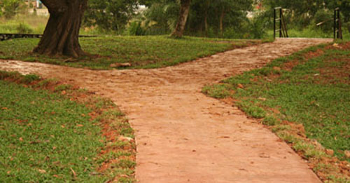
Genesis 12:1 The Lord had said to Abram, “Leave your native country, your relatives, and your father’s family, and go to the land that I will show you.

Slide 2
We must be Fishers of Men

Slide 3
Luke 5:1-11
One day as Jesus was preaching on the shore of the Sea of Galilee, great crowds pressed in on him to listen to the word of God. He noticed two empty boats at the water’s edge, for the fishermen had left them and were washing their nets. Stepping into one of the boats, Jesus asked Simon, its owner, to push it out into the water. So he sat in the boat and taught the crowds from there. When he had finished speaking, he said to Simon, “Now go out where it is deeper, and let down your nets to catch some fish.” When Simon Peter realized what had happened, he fell to his knees before Jesus and said, “Oh, Lord, please leave me—I’m too much of a sinner to be around you.” For he was awestruck by the number of fish they had caught, as were the others with him. His partners, James and John, the sons of Zebedee, were also amazed. Jesus replied to Simon, “Don’t be afraid! From now on you’ll be fishing for people!” And as soon as they landed, they left everything and followed Jesus.

Slide 4
Lessons from Fisherman
Got to Go
  Can’t catch if you don’t go.
  Matthew 28:19-20 – Go into the World

Slide 5
Lessons from Fisherman
Got to Throw
  You have to cast to catch
  Living it can’t always be the case,
    Matthew28:19-20 – train and instruct

Slide 6
Lessons from Fisherman
Got to Show
  Let them see and appealing bait.
  Matthew 5:14-16 – Light to be seen
  The hook is always the same but the method might have to change.
  You might have to get out of the boat.

Slide 7
Lessons from Fisherman
Got to Know
  Got to know who is in charge.
  I Corinthians 3:6 – It is God who must change the heart!

Slide 8

Isaiah 55:8-9
For my thoughts are not your thoughts, neither are your ways my ways, declares the Lord. For as the heavens are higher than the earth, so are my ways higher than your ways and my thoughts than your thoughts.

