Slide 1
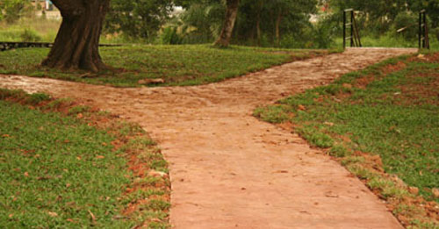
Genesis 12:1 The Lord had said to Abram, “Leave your native country, your relatives, and your father’s family, and go to the land that I will show you.

Slide 2
We must marked by GIVING

Slide 3
I Chronicles 29:10-17
David praised the Lord in the presence of the whole assembly, saying, “Praise be to you, Lord, the God of our father Israel, from everlasting to everlasting. Yours, Lord, is the greatness and the power and the glory and the majesty and the splendor, for everything in heaven and earth is yours. Yours, Lord, is the kingdom; you are exalted as head over all. Wealth and honor come from you; you are the ruler of all things. In your hands are strength and power to exalt and give strength to all. Now, our God, we give you thanks, and praise your glorious name. “But who am I, and who are my people, that we should be able to give as generously as this? Everything comes from you, and we have given you only what comes from your hand.

Slide 4
Realize the Source
  GOD Owns it all!

Slide 5
  What to Give.
    Money 2 Corinthians 9:7 You must each decide in your heart how much to give. And don’t give reluctantly or in response to pressure. “For God loves a person who gives cheerfully.

Slide 6
  What to Give.
    Respect I Peter 3:15b-16a And if someone asks about your hope as a believer, always be ready to explain it But do this in a kind and respectful way.

Slide 7
  What to Give.
    Energy Colossians 3:23 Whatever you do, work at it with all your heart, as working for the Lord, not for human masters,

Slide 8
  What to Give.
    Praise Psalms 106:1 Praise the LORD. Give thanks to the LORD, for he is good; his love endures forever.

Slide 9
How is Your GIVING today?

Slide 10

Isaiah 55:8-9
For my thoughts are not your thoughts, neither are your ways my ways, declares the Lord. For as the heavens are higher than the earth, so are my ways higher than your ways and my thoughts than your thoughts.

