Slide 1
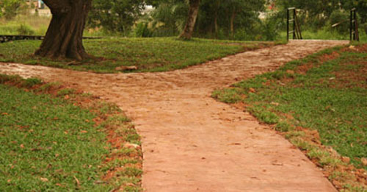
Genesis 12:1 The Lord had said to Abram, “Leave your native country, your relatives, and your father’s family, and go to the land that I will show you.

Slide 2
Needs Holy Discontent!

Slide 3
Nehemiah 1:2-6
I asked them about the Jews who had returned there from captivity and about how things were going in Jerusalem. They said to me, “Things are not going well for those who returned to the province of Judah. They are in great trouble and disgrace. The wall of Jerusalem has been torn down, and the gates have been destroyed by fire.” When I heard this, I sat down and wept. In fact, for days I mourned, fasted, and prayed to the God of heaven. Then I said,“O Lord, God of heaven, the great and awesome God who keeps his covenant of unfailing love with those who love him and obey his commands, listen to my prayer!

Slide 4
Path of Holy Discontent
  What is your one thing!
    For Nehemiah it was the disgrace and trouble of the people and place.
    One Cause in the church not always chasing another rabbit.

Slide 5
Path of Holy Discontent
  Realize that it is never to Late!
    Ben Franklin signed Declaration of Independence at 70.
    Grandma Moses painted first painting at 76.

Slide 6
Path of Holy Discontent
  When you find it feed it!
    Pursue the Passion
      David facing Goliath. He didn’t run away, went straight into battle.
    Nehemiah went to the King even if it cost him his life.

Slide 7
Path of Holy Discontent
  Status Quo will not work!
    Nehemiah knew things had to change, he didn’t just sit and talk and prayer he acted.
    Martin Luther King acted, walked and didn’t just dream
    God heard the dry of the people and sent Moses to free them.

Slide 8
Path of Holy Discontent
  Remember giving hope can make you feel hopeless.
    If you lose hope all hope is gone!
    Rejection doesn’t matter.
    Results are not always in the numbers.

Slide 9
What is it that YOU CAN’T STAND?

Slide 10

Isaiah 55:8-9
For my thoughts are not your thoughts, neither are your ways my ways, declares the Lord. For as the heavens are higher than the earth, so are my ways higher than your ways and my thoughts than your thoughts.

