Slide 1
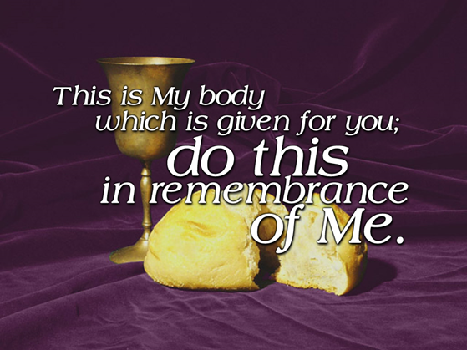

Slide 2
I Corinthians 11:23-26
For I pass on to you what I received from the Lord himself. On the night when he was betrayed, the Lord Jesus took some bread and gave thanks to God for it. Then he broke it in pieces and said, “This is my body, which is given for you. Do this to remember me.” In the same way, he took the cup of wine after supper, saying, “This cup is the new covenant between God and his people, an agreement confirmed with my blood. Does this to remember me as often as you drink it.” For every time you eat this bread and drink this cup, you are announcing the Lord’s death until he comes again.

Slide 3
Right Attitude
I Corinthians 11:20-21 When you meet together, you are not really interested in the Lord’s Supper. For some of you hurry to eat your own meal without sharing with others.

Slide 4
Remember Who?
The Lord Jesus

Slide 5
Real Reason
Then he broke it in pieces and said, “This is my body, which is given for you. Do this to remember me.” In the same way, he took the cup of wine after supper, saying, “This cup is the new covenant between God and his people, an agreement confirmed with my blood.

Slide 6
Relaying the message.
For every time you eat this bread and drink this cup, you are announcing the Lord’s death until he comes again.

