Slide 1
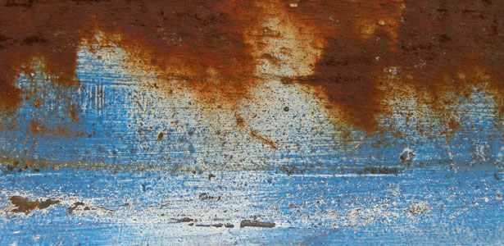
Church
Restoration

Slide 2
Church Restoration
Psalm 51:12
Restore to me the joy of Your salvation, And uphold me by Your generous Spirit.

Slide 3
Church Restoration
Restore
Turn back
Return, come or go back
Return unto, go back, come back

Slide 4
Church Restoration
Joy
Gladness
Exultation
Rejoicing

Slide 5
Church Restoration
Salvation
Deliverance
Rescue
Safety
Victory

Slide 6
Church Restoration
Uphold
Support
Sustain
Brace oneself against

Slide 7
Church Restoration
Generous
Willing
Noble
Free

Slide 8
Church Restoration
Spirit
Breath
Mind
Energy of Life

