Slide 1
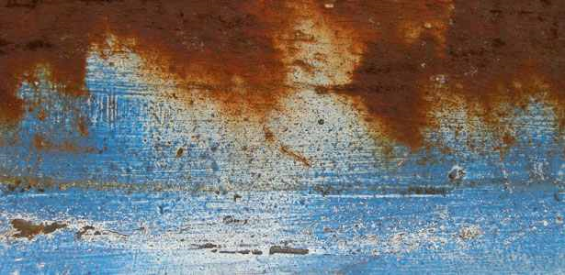
Church
Restoration

Slide 2
Church Restoration
Proverbs 16:18
Pride goes before destruction, and haughtiness before a Fall

Slide 3
Church Restoration
Pride is
Arrogance
In front of
Breaking, Ruin, crushing

Slide 4
Church Restoration
Haughtiness
Loftiness or Pride
In front of
Stumbling or Calamity

