Slide 1
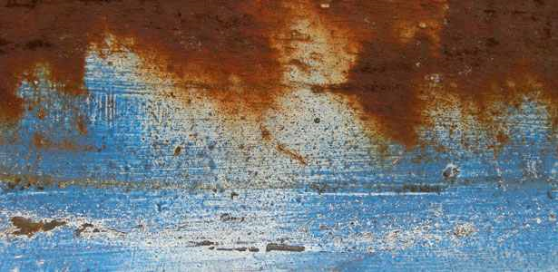
Church
Restoration

Slide 2
Church Restoration
Psalm 51: 12
Restore to me the joy of your salvation,
and uphold me with a willing spirit.
How to Restore?
Be Real

Slide 3
James 4:6-8a Humble yourselves in the sight of the Lord. Submit yourselves therefore to God. Resist the devil, and he will flee from you. 8 Draw near to God, and he will draw near to you.

Slide 4
• Humble –
o lowly in spirit
o Deporting one’s self

Slide 5
• Submit –
Put in Subjection,
To yield to ones control

Slide 6
• Resist –
o To withstand,
o to Oppose

Slide 7
• Draw –
o join one thing to another
O Come Near
o approach

Slide 8
The questions:
Are you being REAL?
Is the life you live on Sunday the same life you live Monday through Saturday.

