Slide 1
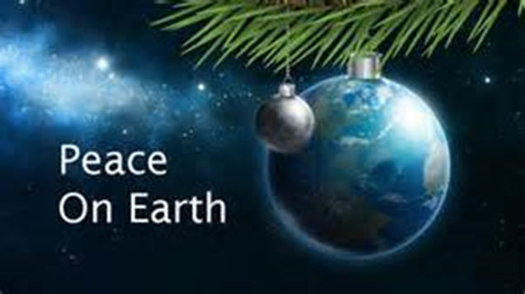
Peace on Earth

Slide 2
Isaiah 9:6
For to us a child is born, to us a son is given, & the government will be upon his shoulders. And He will be called Wonderful Counselor, Mighty God, Everlasting Father, Prince of Peace.”

Slide 3
Proverbs 25:21-22
If your enemy is hungry, give him food to eat; if he is thirsty, give him water to drink. In doing this, you will heap burning coals on his head, and the Lord will reward you.
You Need to PROVIDE to show Peace

Slide 4
Exodus 23:4
If you meet your enemy's ox or his donkey wandering away, you shall surely return it to him. If you see the donkey of one who hates you lying helpless under its load, do not leave it there, be sure you help him with it.“
You Need to SERVE to show Peace

Slide 5
II Kings 6
Helpless, they were easily taken as prisoners, & the King of Israel wanted to kill them all. But Elisha said, “You shall not kill them . . . Set bread & water before them, that they may eat & drink & go to their master. So he prepared a great feast for them; "and when they had finished eating & drinking he sent them away, & they went back to their master. And the marauding bands of Syria did not come again into the land of Israel.
You Need to Help the Helpless to show Peace

Slide 6
We need to be the Hands and Feet of Jesus. Jesus was the Prince of Peace!
Will you be like HIM?

