Slide 1
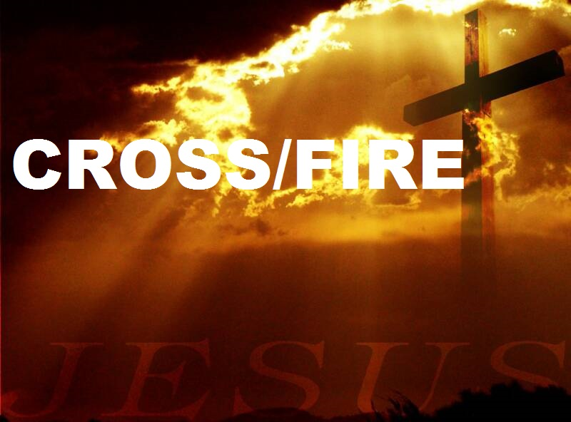
The Cross and God

Slide 2
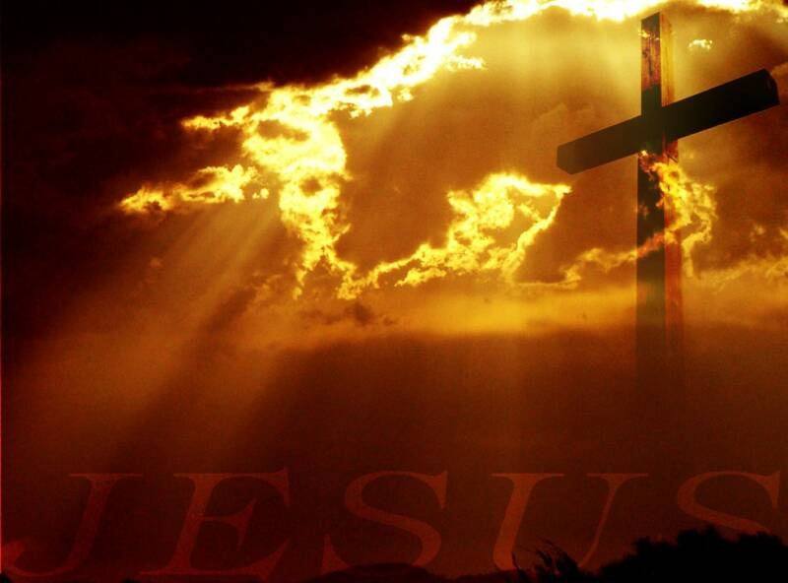
Romans 3:24
and are justified by his grace as a gift, through the redemption that is in Christ Jesus

Slide 3
God’s Grace
  Justified -to declare, pronounce, one to be just, righteous.
  Through the work of the Christ
  It not what we do but what He DID

Slide 4
Romans 3:25
whom God put forward as a propitiation by his blood, to be received by faith. This was to show God's righteousness, because in his divine forbearance he had passed over former sins.

Slide 5
God’s Wrath
  propitiation,
    To turn away wrath by the offering of a gift.
    Context it means that the death of Christ turns away God’s wrath.
    Leviticus 16 Day of Atonement.

Slide 6
Romans 3:26
It was to show his righteousness at the present time, so that he might be just and the justifier of the one who has faith in Jesus.

Slide 7
God’s Justice
  God is Holy
  Sin Must be punished
  God is both just (in punishing sin) and the justifier of those who believe in Jesus.

