Slide 1
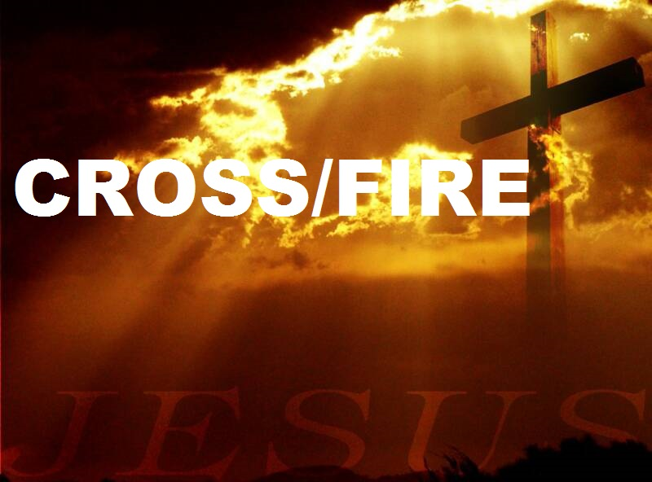
The New Covenant

Slide 2
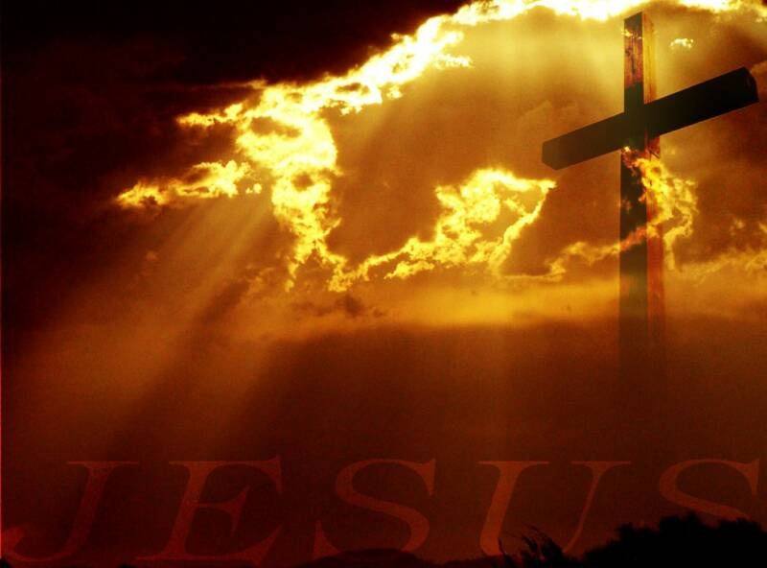
When the hour came, Jesus and his apostles reclined at the table. And he said to them, “I have eagerly desired to eat this Passover with you before I suffer. For I tell you, I will not eat it again until it finds fulfillment in the kingdom of God.” After taking the cup, he gave thanks and said, “Take this and divide it among you. For I tell you I will not drink again from the fruit of the vine until the kingdom of God comes.” And he took bread, gave thanks and broke it, and gave it to them, saying, “This is my body given for you; do this in remembrance of me.” In the same way, after the supper he took the cup, saying, “This cup is the new covenant in my blood, which is poured out for you.

Slide 3
The Lord’s Table is
  A place that cleanses our hearts by faith and sets us free from the judgment and wrath of God.
  A place for healing and for the restoration of all broken relationships
o A place to enjoy our fellowship with the Lord and with one another
o A place to be strengthened so that we can serve our Lord and Saviour Jesus Christ.

Slide 4
A place that cleanses our hearts by faith and sets us free from the judgment and wrath of God.
A place for healing and for the restoration of all broken relationships

Slide 5
A place to enjoy our fellowship with the Lord and with one another
o A place to be strengthened so that we can serve our Lord and Saviour Jesus Christ.

