Slide 1
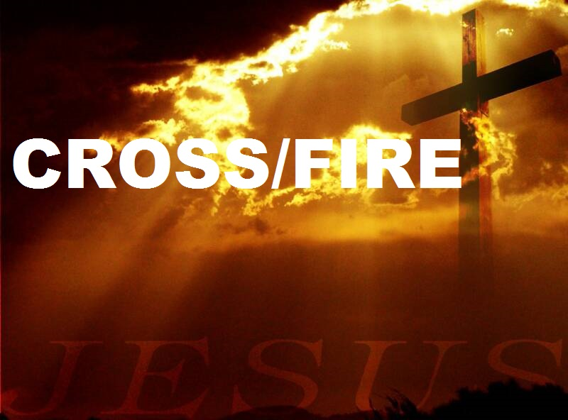
The Road to the Cross

Slide 2
Connect verse for the week.
John 12:13
They took branches of palm trees and went out to meet Him, and cried out: “Hosanna!
‘Blessed is He who comes in the name of the Lord!’ The King of Israel!”

Slide 3
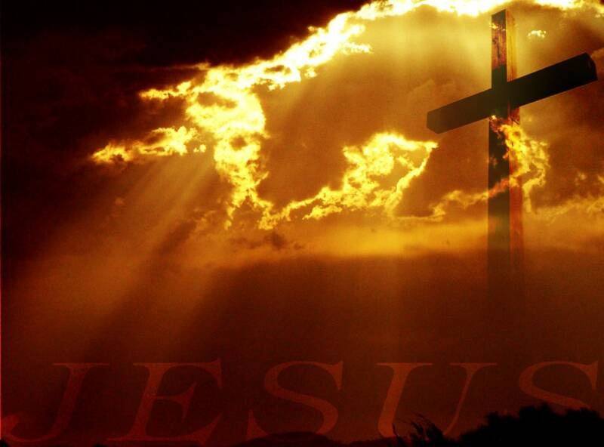
The Result was Realized
  Matthew 16: 21
    From then on Jesus began to tell his disciples plainly that it was necessary for him to go to Jerusalem, and that he would suffer many terrible things at the hands of the elders, the leading priests, and the teachers of religious law. He would be killed, but on the third day he would be raised from the dead.

Slide 4
The Praise was Pure
o John 12:13 They took branches of palm trees and went out to meet Him, and cried out: “Hosanna!
‘Blessed is He who comes in the name of the Lord!’ The King of Israel!”

Slide 5
The Religious were Real Worried
John 11:19 The Pharisees therefore said among themselves, “You see that you are accomplishing nothing. Look, the world has gone after Him!”

Slide 6
The Relationship was Real
John 11:30-33 Jesus answered and said, “This voice did not come because of Me, but for your sake. Now is the judgment of this world; now the ruler of this world will be cast out. And I, if I am lifted up from the earth, will draw all peoples to Myself.” This He said, signifying by what death He would die.

