Slide 1

The Cross Defeated

Slide 2
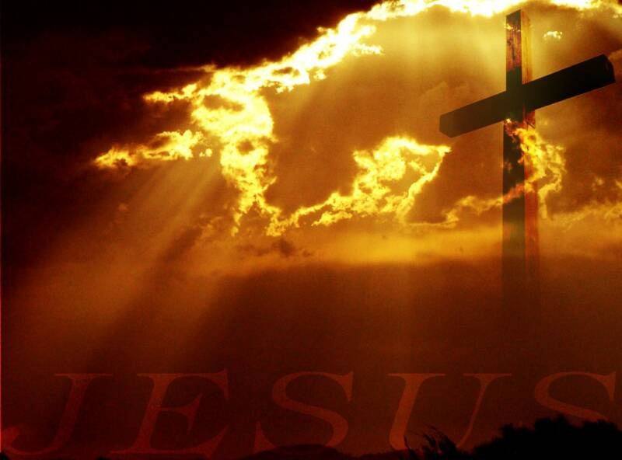
Prepare- Verse 1
  But very early on Sunday morning the women went to the tomb, taking the spices they had prepared.

Slide 3
Puzzled – Verses 2-4
  They found that the stone had been rolled away from the entrance.
  So they went in, but they didn’t find the body of the Lord Jesus.
  As they stood there puzzled, two men suddenly appeared to them, clothed in dazzling robes.

Slide 4
  Promise- Verses 5-8
    The women were terrified and bowed with their faces to the ground. Then the men asked, “Why are you looking among the dead for someone who is alive? He isn’t here! He is risen from the dead! Remember what he told you back in Galilee, that the Son of Man must be betrayed into the hands of sinful men and be crucified, and that he would rise again on the third day.”
    Then they remembered that he had said this.

Slide 5
Praise – Verse 10
It was Mary Magdalene, Joanna, Mary the mother of James, and several other women who told the apostles what had happened.

