Slide 1
Connect to Community
Fingers or Fists!
Generosity

Slide 2
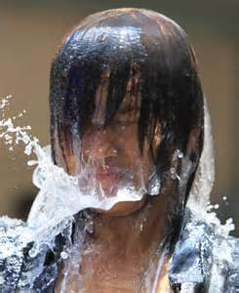
Word Pictures
Saturate with Water
Overflowing
Ready to Give

Slide 3
Truth One
It’s not Mine: Palms 24:1
J. D. Rockefeller said, “I never would have been able to tithe the first million dollars I ever made if I had not tithed my first salary, which was $1.50 per week.”
The earth is the LORD's, and everything in it, the world, and all who live in it;

Slide 4
Truth Two
It’s on YOU 2 Corinthians 9:6
The Building Fund
He who sows sparingly will also reap sparingly, and he who sows bountifully will also reap bountifully

Slide 5
Truth Three
It’s a heart issue: 2 Corinthians 9:7
So let each one give as he purposes in his heart, not grudgingly or of necessity

Slide 6
Truth Four
It’s will be remembered:
2 Corinthians 9:9
As it is written: “He has dispersed abroad, He has given to the poor; His righteousness endures forever.”

Slide 7
Truth Five
It’s contagious:
2 Corinthians 9:11
Yes, you will be enriched in every way so that you can always be generous.

Slide 8
Truth Six
It brings praise to God: 2 Corinthians 9: 12
The Orphan and the Soldier Story
So two good things will result from this ministry of giving, the needs of the believers in Jerusalem will be met, and they will joyfully express their thanks to God.

Slide 9
• Actions Point: Sit down with God and make a commitment to begin on the road toward outrageous generosity. Once you and God find a place to begin, as you see His blessing and your trust in Him begins to grow, move your amount up until you arrive at the place where you fully trust Him in your

