Slide 1
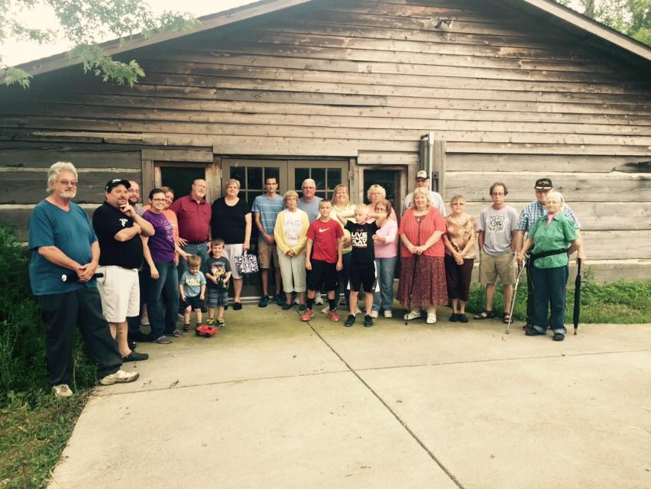
Where are We Going! A Bigger Vision Three Choices Luke 5:1-11

Slide 2
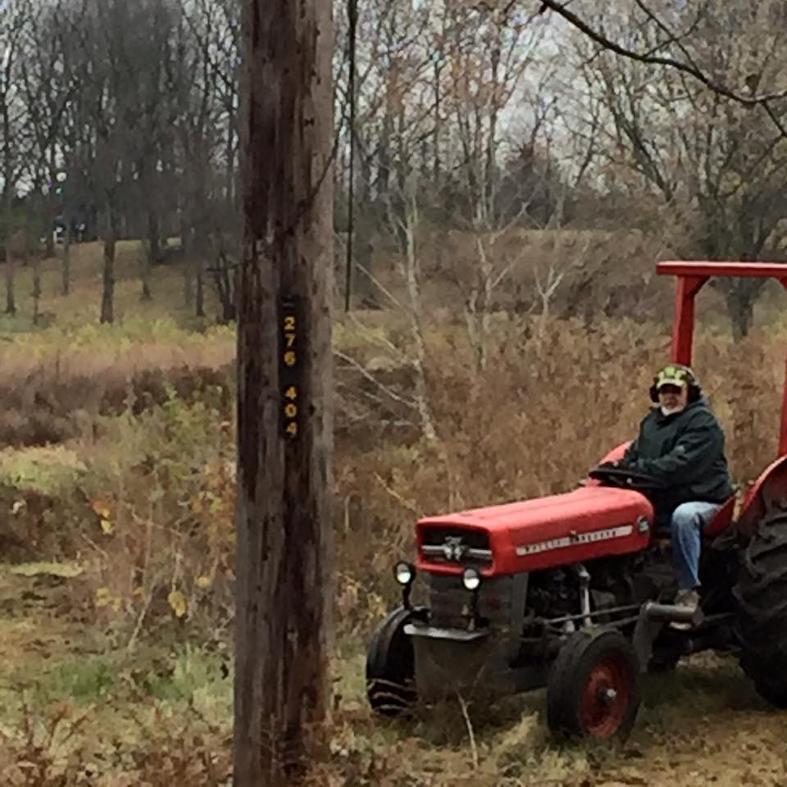
You have a choice about what you what you’re going to build your life around. Away for what we think we know to what we don’t Know Launch out into the deep and let your nets down

Slide 3
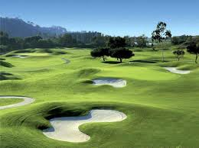
You have a choice to invest your life in the things of this world Look at all these fish we caught, it was so big we need help! Money, Fame And Fortune Psalm 103:15-16: “As for man, his days are like grass, he flourishes like a flower of the field; the wind blows over it and it is gone, and its place remembers it no more.”

Slide 4
You have a choice to invest in that which is eternal… the Kingdom of God!
.For I am a sinful man
Still fishing just bigger fish( Your job, Your passion, His bigger vision
They forsook all and followed HIM!
Psalms 112:6 Surely he will never be shaken; The righteous will be in everlasting remembrance.

