Slide 1
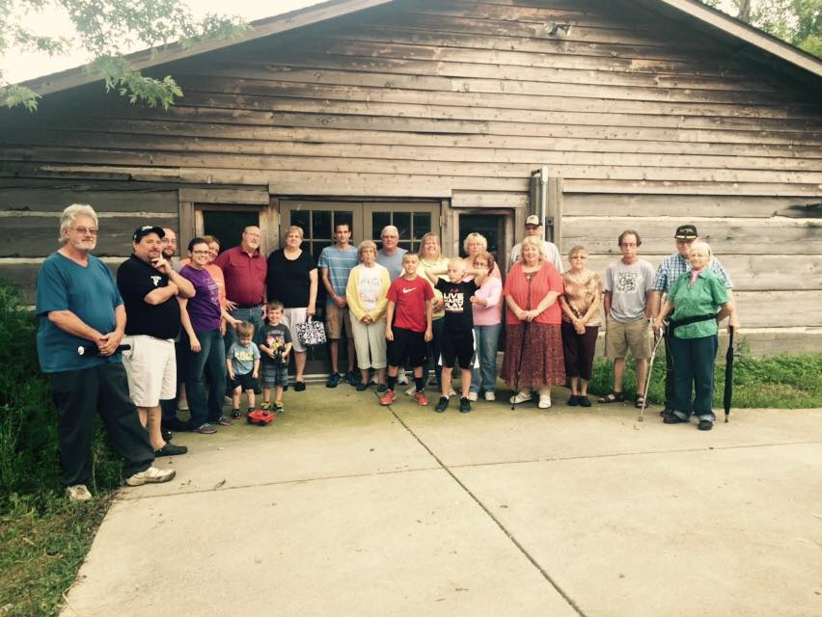
Where are We Going! Purpose One
Worship

Slide 2
Therefore, I urge you, brothers, in view of God’s mercy, to offer your bodies as living sacrifices, holy and pleasing to God--this is your spiritual act of worship." –
Worship is a continuous offering to God of all that we have and all that we are. It is giving ourselves utterly and completely to God, and being willing for him to direct our lives however he sees fit.

Slide 3
Three areas in which we worship:
Thoughtfully-
"Don’t copy the behavior and customs of this world, but let God transform you into a new person by changing the way you think." – Romans 12:2a, NLT

Slide 4
Passionately-
"Jesus said, ’The first in importance is, "Listen, Israel: The Lord your God is one; so love the Lord God with all your passion and prayer and intelligence and energy."’" – Mark 12:30, Msg

Slide 5
Practically-
"And whatever you do, whether in word or deed, do it all in the name of the Lord Jesus, giving thanks to God the Father through him. . . Whatever you do, work at it with all your heart, as working for the Lord, not for men." – Colossians 3:17, 23, NIV

