Slide 1
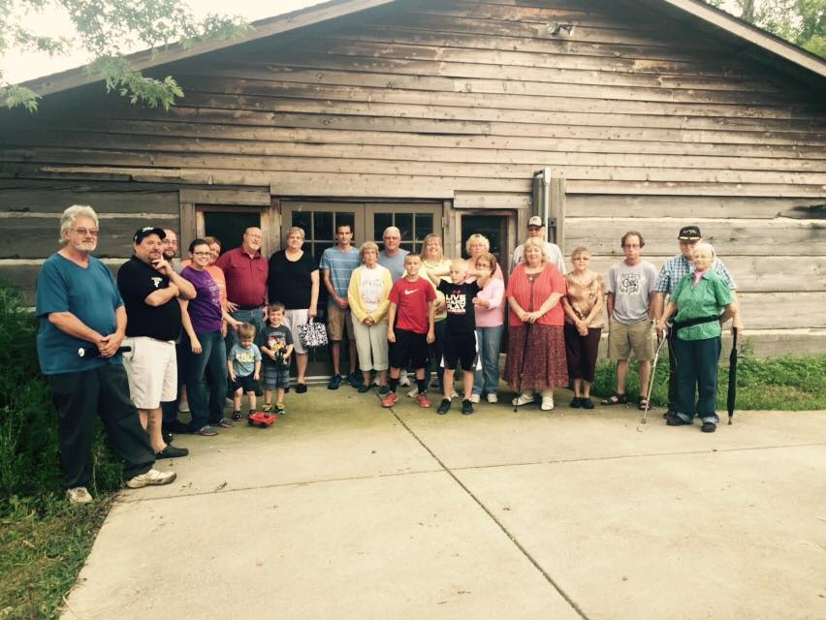
Where are We Going! Fellowship

Slide 2
I Corinthians 12:24-26 The way God designed our bodies is a model for understanding our lives together as a church: every part dependent on every other part, the parts we mention and the parts we don’t, the parts we see and the parts we don’t. If one part hurts, every other part is involved in the hurt, and in the healing. If one part flourishes, every other part enters into the exuberance.

Slide 3
What is Fellowship?
Usually thought of social functions
Fried Chicken at the Potluck Dinner
All True, but Much Deeper
Koinonia - Sharing, participation, deep fellowship define by:

Slide 4
Love one another (John 13:34-35)
Members of one another (Rom 12:5)
Devoted to one-another in brotherly love... (Rom 12: 10)
Be of the same mind toward one another... (Rom 12:16)
Accept one another (Romans 15:7)
Admonish one another (Rom 15:14)

Slide 5
Care for one another (I Corinthians 12:25)
Serve one another (Galatians 5:13; John 13:14)
Bear one another's burdens (Galatians 6:2)
Be kind to one another, tenderhearted, forgiving... (Ephesians 4:32)
Be subject to one another ... (Ephesians 5:21)
Bear with one another, Forgive one another (Colossians 3:13)
Do not lie to one another (Col 3:9)
Teach and admonish one another... (Colossians 3:16)

Slide 6
Build up one another (I Thessalonians 5:11)
Live at peace with one another (I Thess 5:13)
Stimulate one another to love and good deed (Heb 10:24)
Encourage one another... (Hebrews 10:25)
Do not speak against one another (Jas 4:11)
Confess your sins to one another, (James 5:16)
Pray for one another (James 5:16)
Fervently love one another from the heart (I Peter 1:22)
Be hospitable to one another (I Peter 4:9)

Slide 7
Are you having the correct
type of Fellowship?

