Slide 1
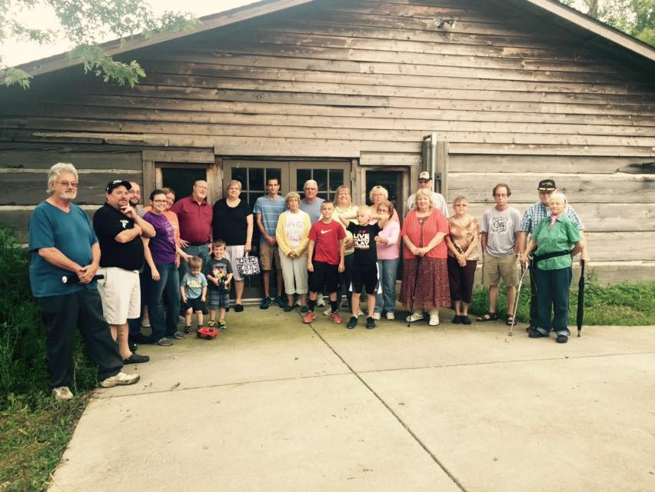
Where are We Going!
Discipleship

Slide 2
Then we will no longer be immature like children. We won’t be tossed and blown about by every wind of new teaching. We will not be influenced when people try to trick us with lies so clever they sound like the truth. Instead, we will speak the truth in love, growing in every way more and more like Christ, who is the head of his body, the church.”
Ephesians 4:14-15 NLT

Slide 3
God knew what he was doing from the very beginning. He decided from the outset to shape the lives of those who love him along the same lines as the life of his Son.
Romans 8:29 MSG

Slide 4
Troubles
“Dear brothers and sisters, when troubles of any kind come your way, consider it an opportunity for great joy. For you know that when your faith is tested, your endurance has a chance to grow. So let it grow, for when your endurance is fully developed, you will be perfect and complete, needing nothing. James 1:2-4 NLT

Slide 5
Temptations
God does tempt.
Is it a stepping stone or stumbling block
Obey God or Satan
It is not sin to be tempted
Everyone is tempted
1 Cot. 10:13 says,”No temptation has seized you except what is COMMON to man.”
Test of our love
Money over God
Pleasure over God
Etc.

Slide 6
Winning the battle
Stay away
Stay focused on the right Philippians 4
Stay connected to the right person.

Slide 7
Trespasses
“For to this you have been called, because Christ also suffered for you, leaving you an example, so that you might follow in his steps.When he was reviled, he did not revile in return; when he suffered, he did not threaten, but continued entrusting himself to him who judges justly.” 1 Peter 2:21, 23

Slide 8
Are you looking
more like Christ?

