Slide 1
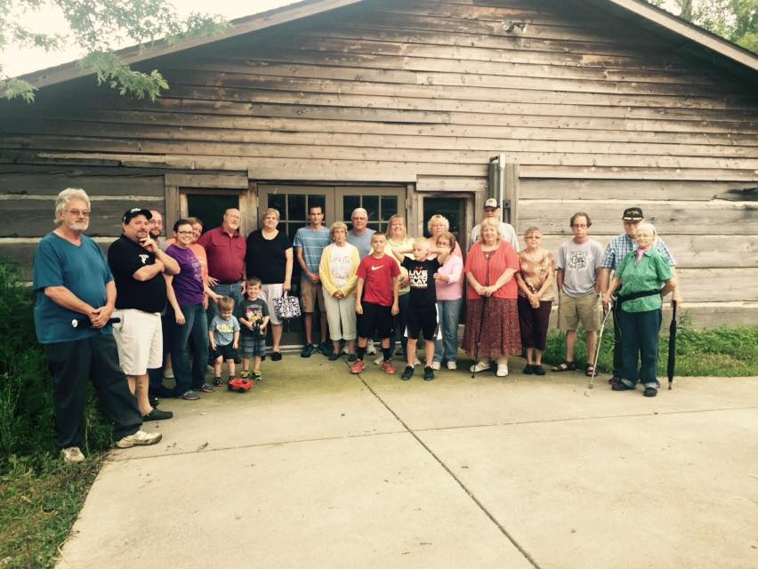
Where are We Going! Serving

Slide 2
Matthew 20:28
Just as the Son of Man did not come to be served, but to serve, and to give his life as a ransom for many.”

Slide 4
Crafted for Serving
He creates each of us by Christ Jesus to join him in the work he does, the good work he has gotten ready for us to do, work we had better been doing. ‭‭
Ephesians‬ ‭2:10‬ ‭MSG‬‬

Slide 5
Connects us to Christ
So, my dear brothers and sisters, this is the point: You died to the power of the law when you died with Christ. And now you are united with the one who was raised from the dead. As a result, we can produce a harvest of good deeds for God.
‭‭Romans‬ ‭7:4‬ ‭

Slide 6
Christ is served not humans
Work willingly at whatever you do, as though you were working for the Lord rather than for people. Remember that the Lord will give you an inheritance as your reward, and that the Master you are serving is Christ.
Colossians 3:23-24

Slide 7
Christ gives great rewards for serving
Anyone who wants to serve me must follow me, because my servants must be where I am. And the Father will honor anyone who serves me.”
‭‭John‬ ‭12:26‬ ‭

Slide 8
Are you Serving?

