Slide 1
What Do You Want?
II Kings 4:1-7
Matthew 9:27-31

Slide 2
Everyone has a Problem
Blindness
Broke

Slide 3
Everyone wants the problem FIXED
“Three times I pleaded with the Lord about this, that it should leave me.”
‭‭2 Corinthians‬ ‭12:8‬‬‬

Slide 4
Everyone needs to ADMIT they have a problem
"Jesus have mercy on us."
Matthew 9:27
"But the creditor has come to take away my two sons."
2 Kings 4:1b

Slide 5
Everyone take their NOTHING and do something
"Your servant has nothing, except a jar of oil."
2 Kings 4:2b
“And as Jesus passed on from there, two blind men followed him"
‭‭Matthew‬ ‭9:27‬a

Slide 6
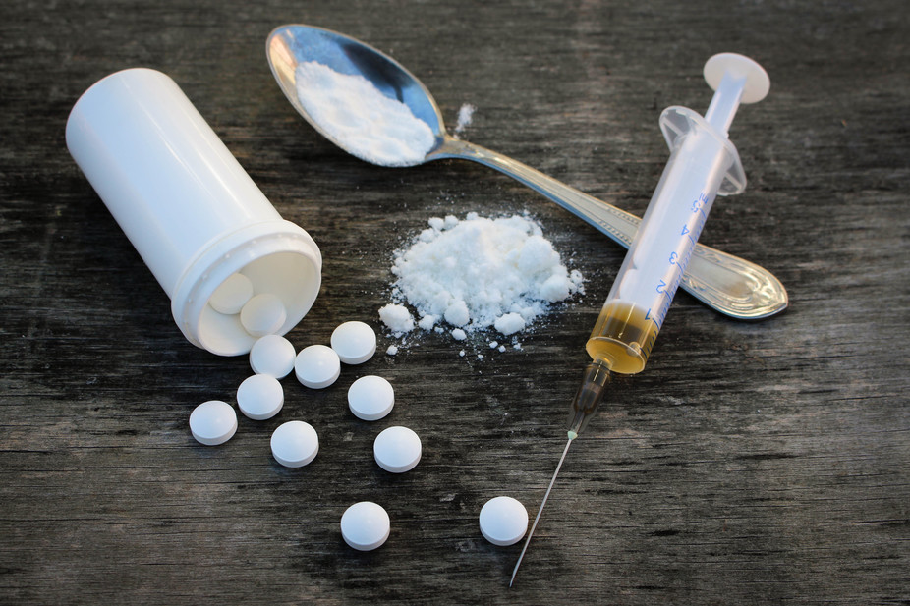
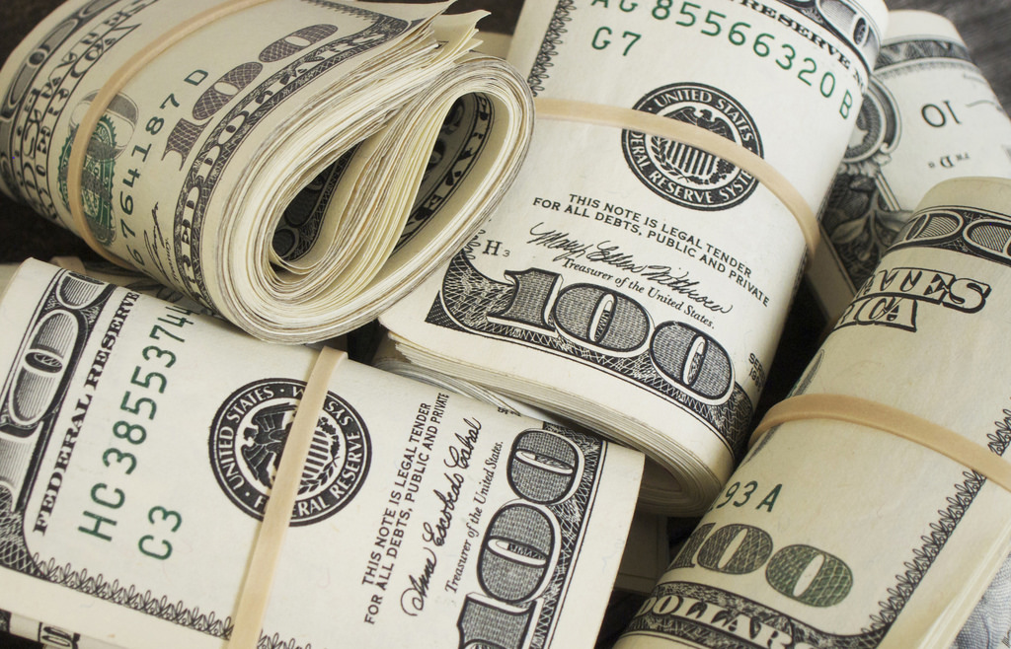
Who will you turn to this year?

